Slide 1
Study Research
Analysis of Stock Price Variance Close To Annual And Quarterly Report Filing Dates
Nelson Corrocher, M.B.A.
Adela Devarajan
Nikoloz Lelashvili

Slide 2
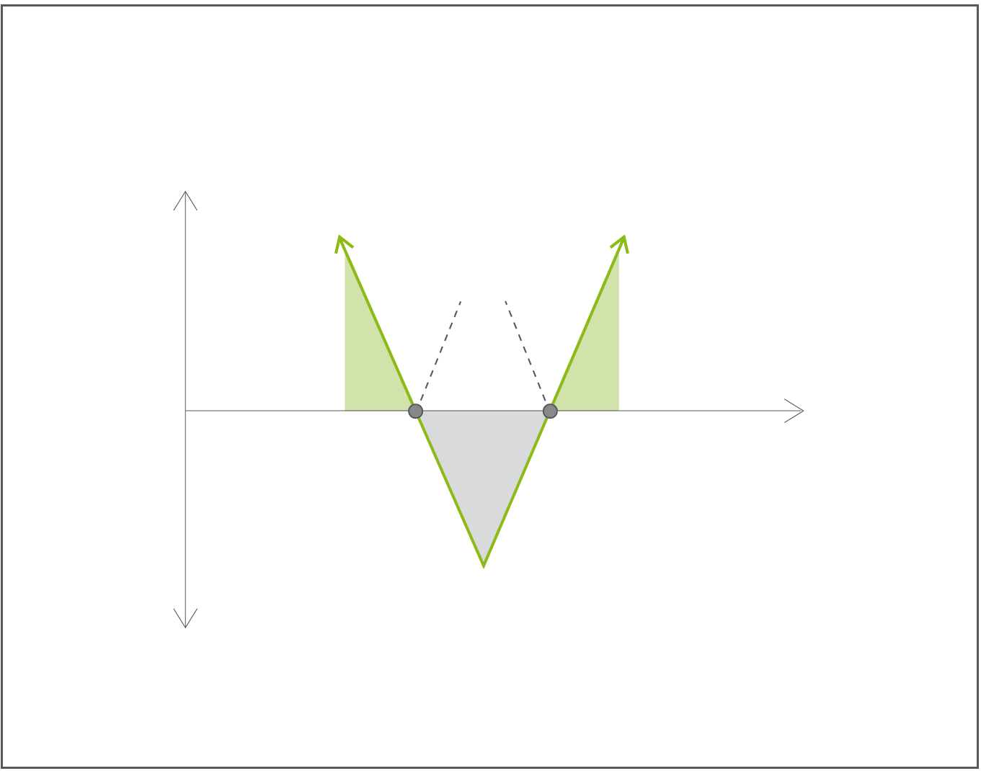
Option Straddle: Definition
Strategy in which the investor holds a position in both a call and put with the same strike price and expiration date, paying both premiums. This strategy allows the investor to make a profit regardless of whether the price of the security goes up or down, assuming the stock price changes somewhat significantly.
Profit
Breakeven
Profit
Profit
Stock Price
Loss
Loss

Slide 3
Hypothesis:
“Price variance of public companies stocks increase close to the filing date of its financial statements”
If true:
Potential for systematic straddling strategy with higher Sharpe Ratio⁽¹⁾ than other passive strategies.
⁽¹⁾ measure for calculating risk-adjusted return.

Slide 4
Procedure
R scripting used for almost entire procedure:
Data collection
Web scraping:
SEC.org EDGAR;
Yahoo Finance;
Data clean-up;
Data transformation;
Data tidying;
Analysis
Variance test;
Hypothesis test;
Data plotting;
Paper Creation
Paper formatting;
Reproducibility;
Bibliography;

Slide 5

Results
## [1] "Regular set variance: 0.99"
## [1] "Release set variance: 1.09"
##
## F test to compare two variances
##
## data: finalData.reg and finalData.fin
## F = 0.9, num df = 30000, denom df = 3000, p-value = 6e-04
## alternative hypothesis: true ratio of variances is not equal to 1
## 95 percent confidence interval:
## 0.86 0.96
## sample estimates:
## ratio of variances
## 0.91

Slide 6
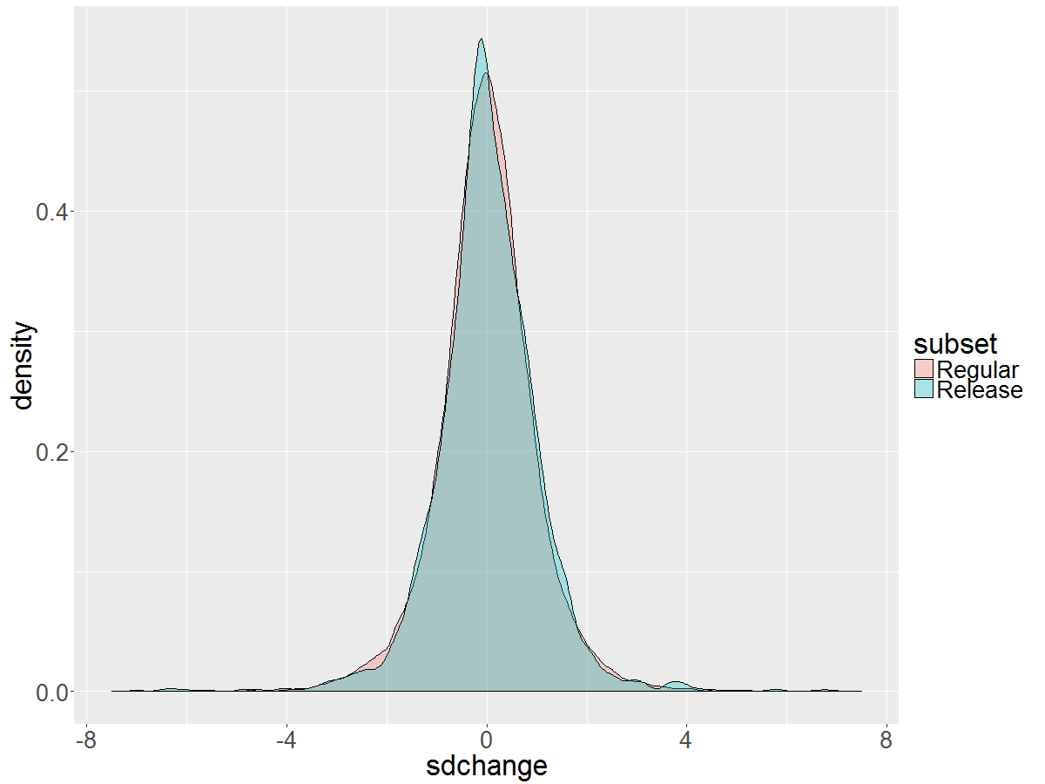
Results – Superposed distribution density of the two datasets.

Slide 7
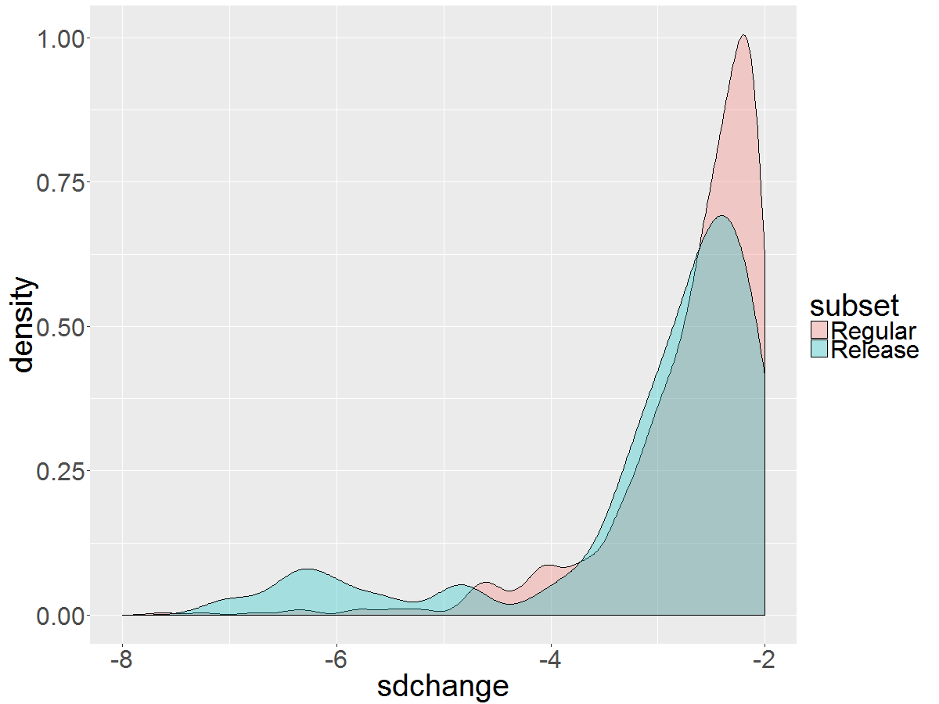
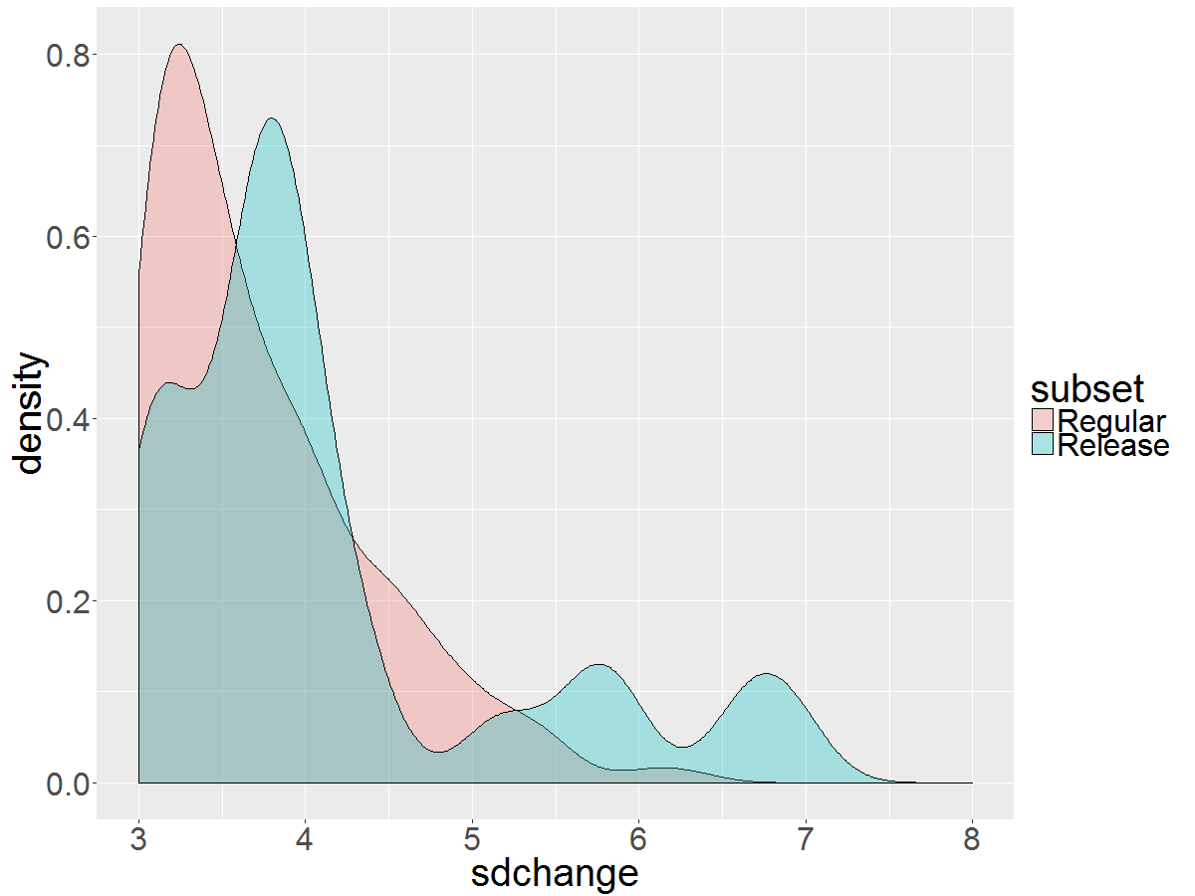
Results – Distribution zoomed on tails
Left Tail
Right Tail
Distribution gets very different in the tails especially below -5 and above 5.

Slide 8
Results – Distribution zoomed on tails
Left Tail
Right Tail
Distribution gets very different in the tails especially below -5 and above 5.

Slide 9
Study Research – PART II
Calculating profitability of creating straddles around filing dates and back-testing results
Nelson Corrocher, M.B.A.
Sergii Savchuk

Slide 10
Environment
Using data from CBOE
Only one data sample – not freely available
Using IBM stocks and options
Using filing date of 2013-04-30

Slide 11
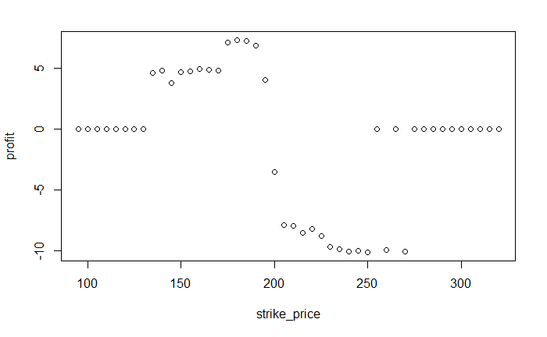
Plotting with fixed expiration date in 2013-05-03

Slide 12
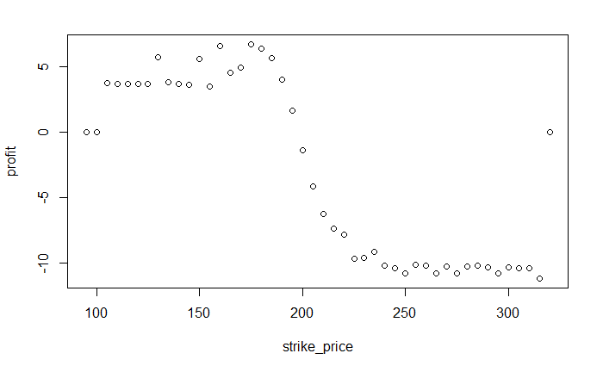
Plotting with fixed expiration date in 2013-06-22

Slide 13
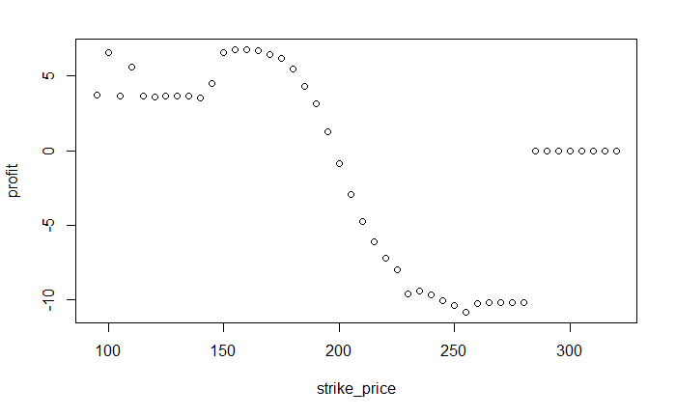
Plotting with fixed expiration date in 2013-07-20

Slide 14
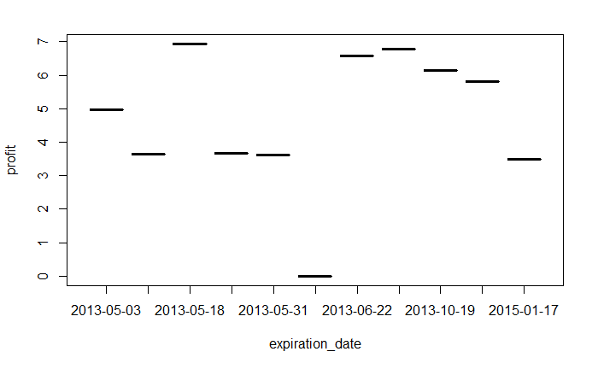
Plotting with fixed strike price in 160

Slide 15
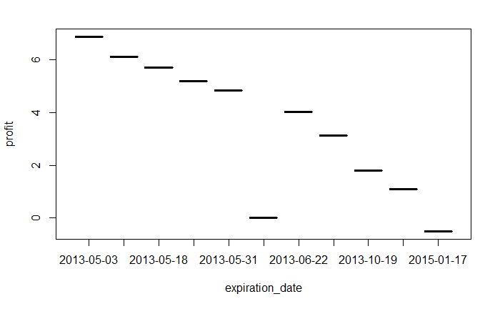
Plotting with fixed strike price in 190

Slide 16
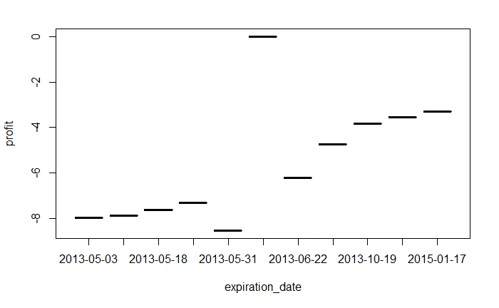
Plotting with fixed strike price in 210

Slide 17
Next Steps
Finding a sponsor willing to buy the CBOE historical options data;
Running tests for the entire data sample;
Finding the sweet spot relating to underlying stocks, expiration dates and strike prices;
Comparison between actual prices and black-scholes mode

Slide 18

THANKS!

